Slide 1
Sun & Star Marketplace
Group Member:
Kuan Yong Tan
Ankita Verma
Astha Sharma
Ankita Tungidwar
Mohammad Azim
Rohit Prajapati
Simran Tungidwar
Saad Khan

Slide 2
Process Flow Chart

Slide 4
ER Diagram and Database

Slide 5
ER Diagram

Slide 6
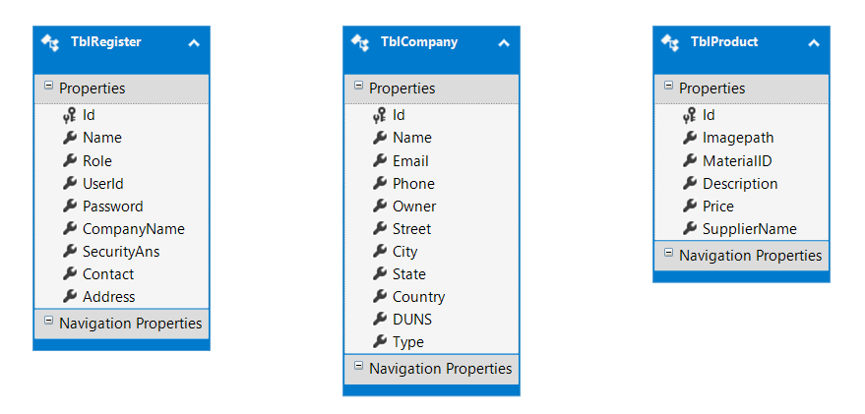
Database and Tables

Slide 7
App Component, Module and Routing

Slide 8
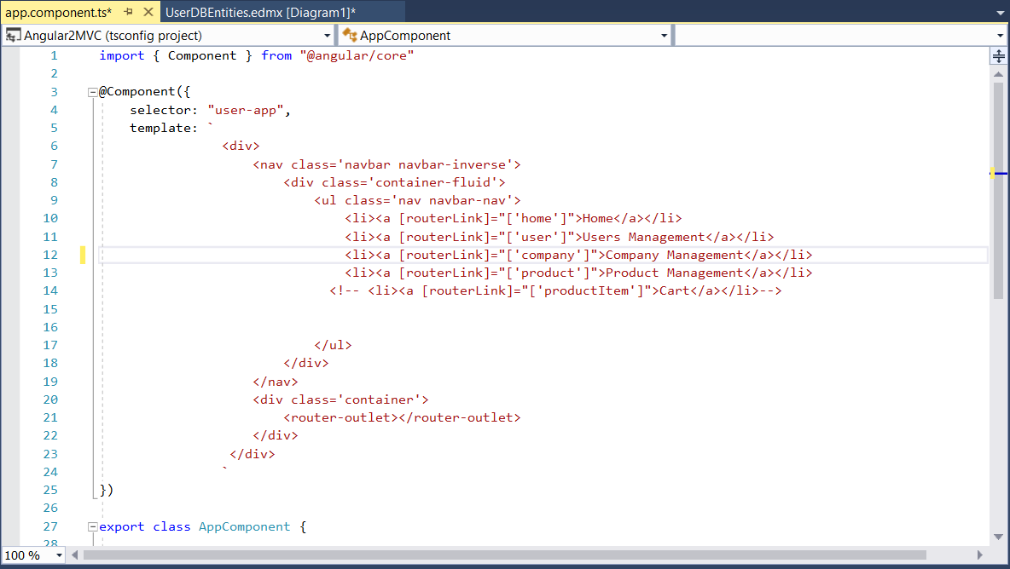
App.Component.ts

Slide 9
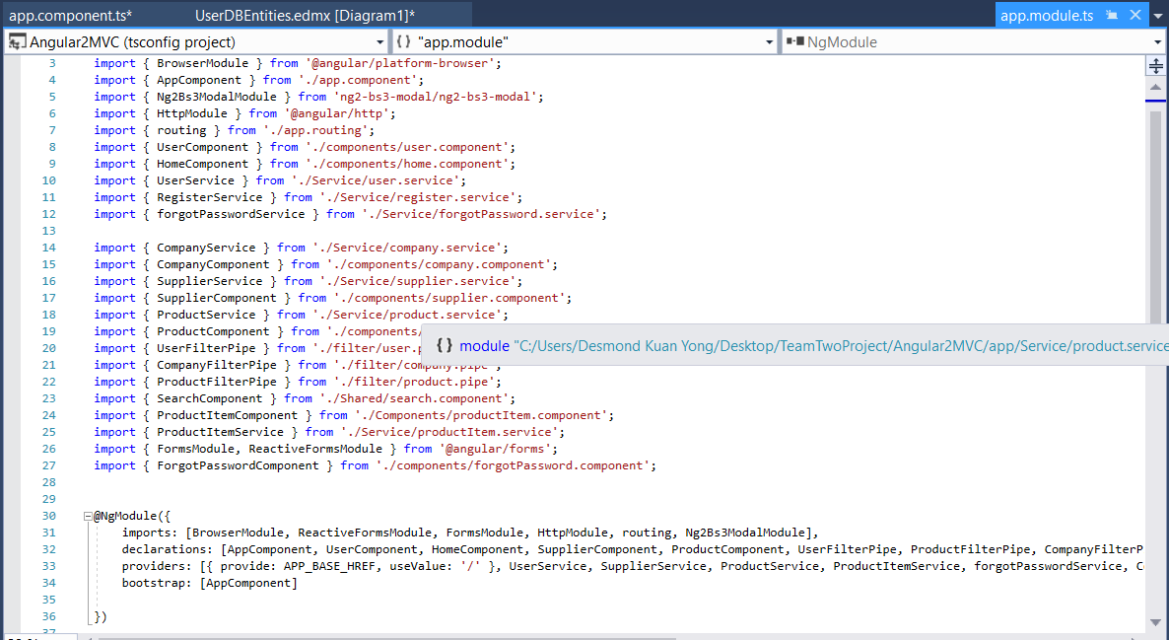
App.Module.ts

Slide 10
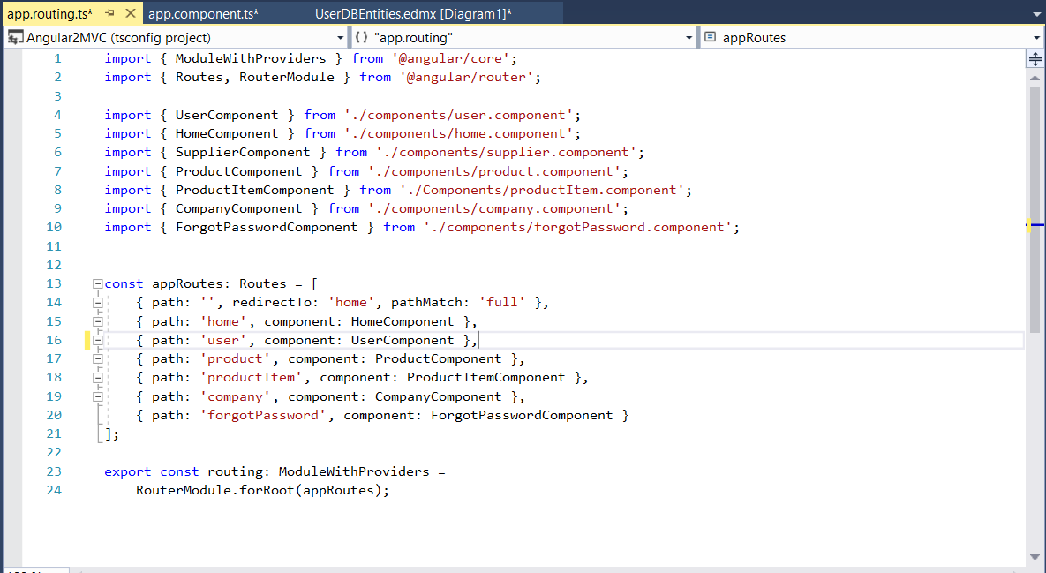
App.Routing.ts

Slide 11
Process Steps
Login and Registration Page
Company Management
Product Management
Shopping Cart

Slide 13
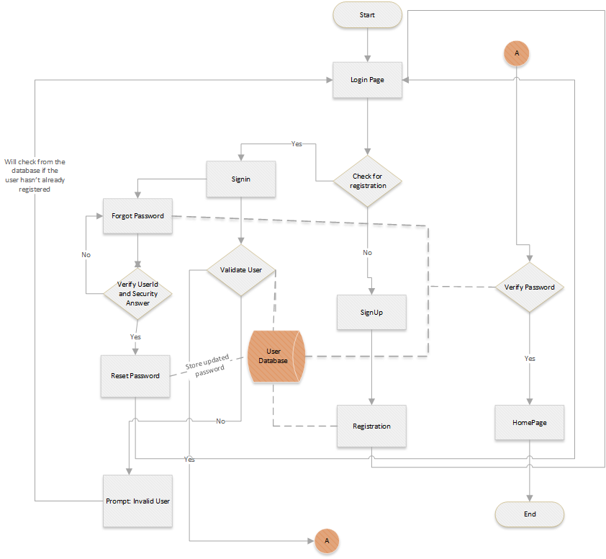

Slide 14
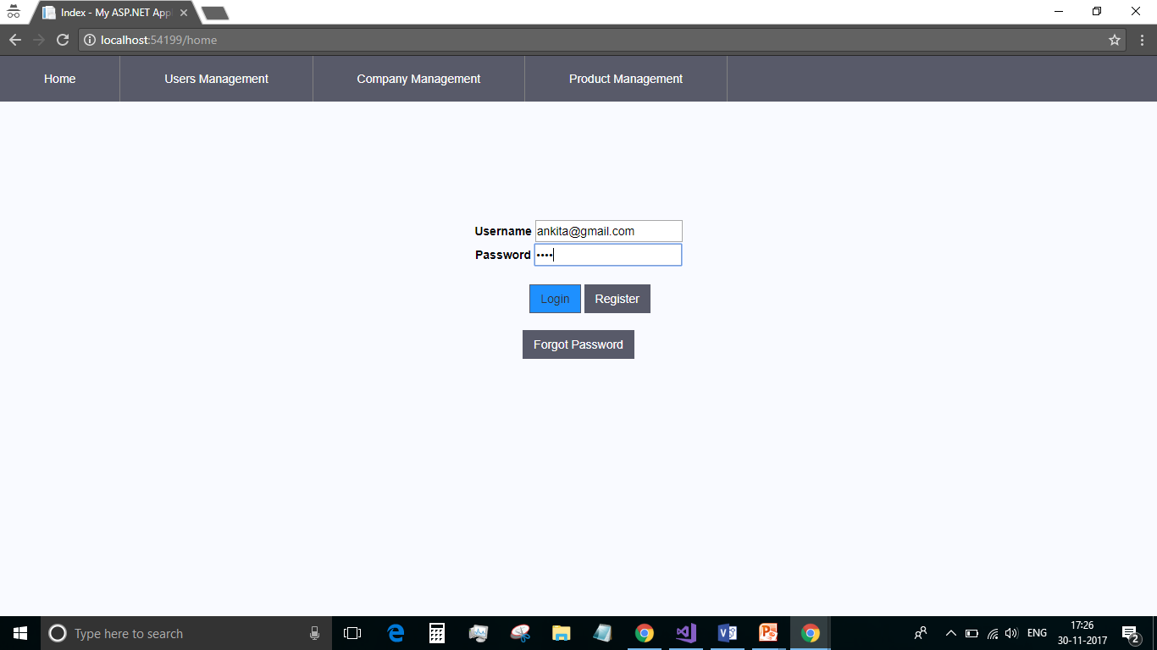
LOGIN Page

Slide 15
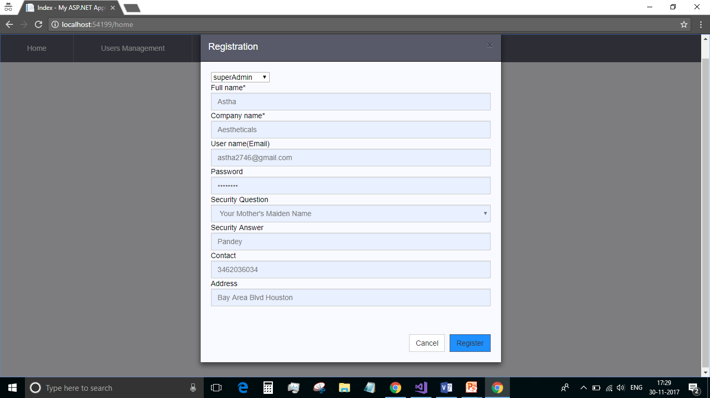
Registration

Slide 16
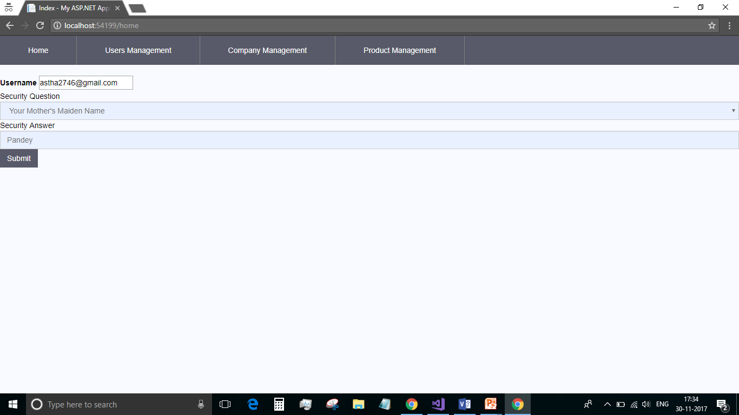
Forgot Password

Slide 17
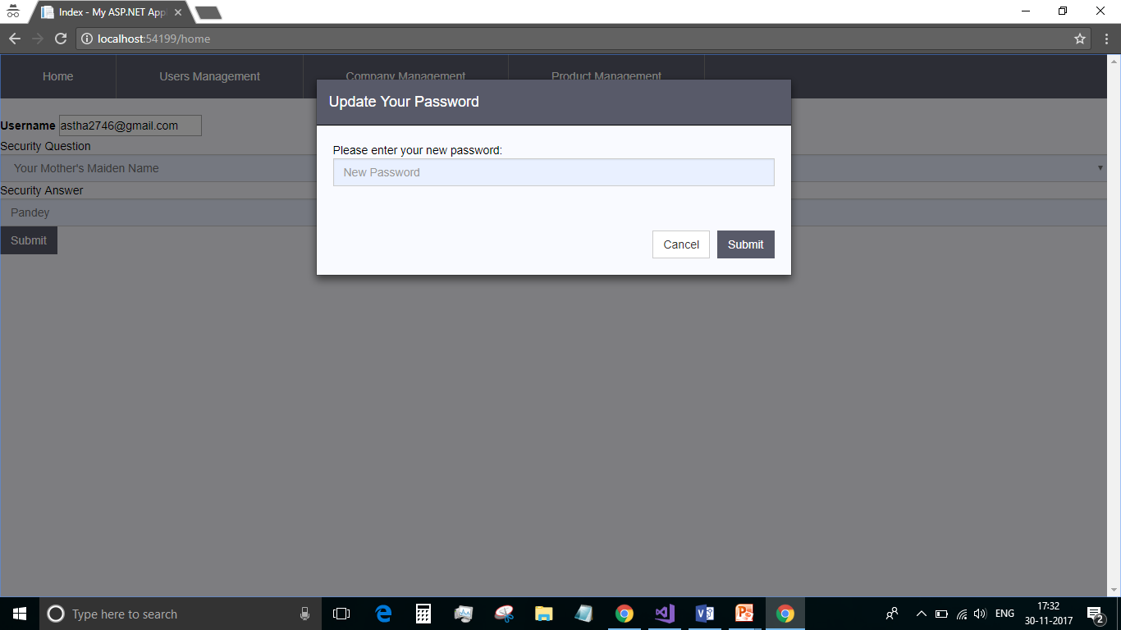
Reset Password

Slide 18
COMPANY MANAGNMENT PAGE

Slide 19
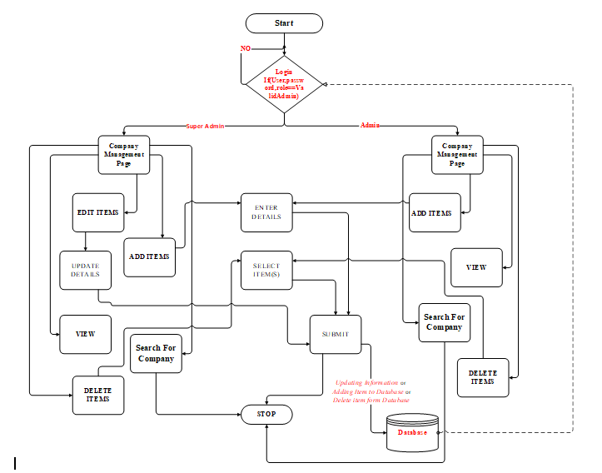
FLOWCHART:

Slide 20
ER DIAGRAM:

Slide 21
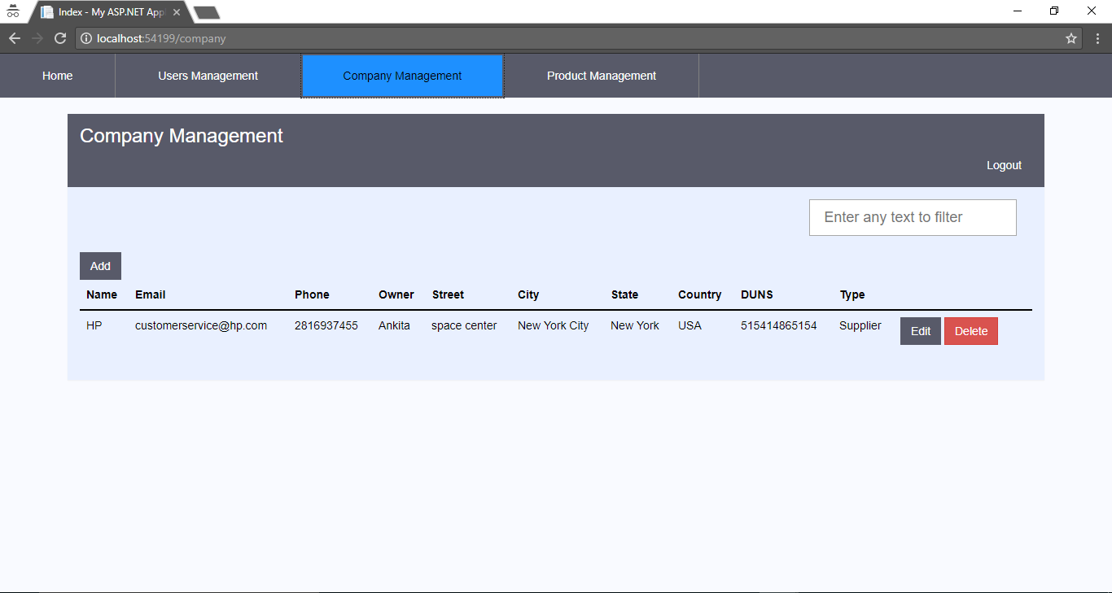
Admin: Login

Slide 22
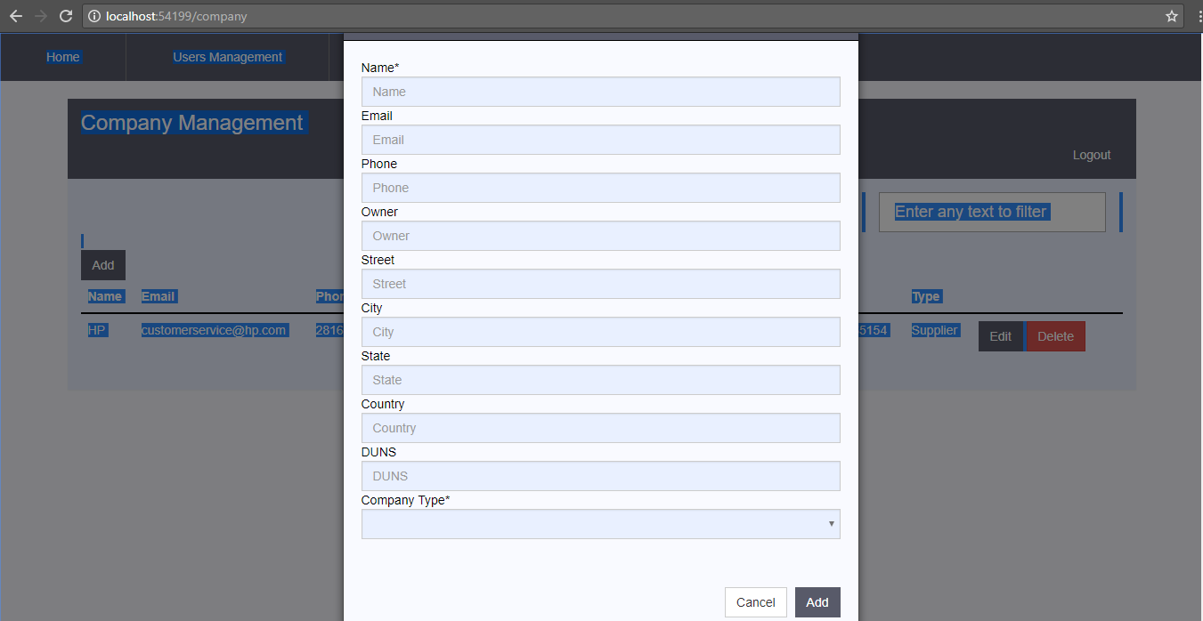
ADD:

Slide 23
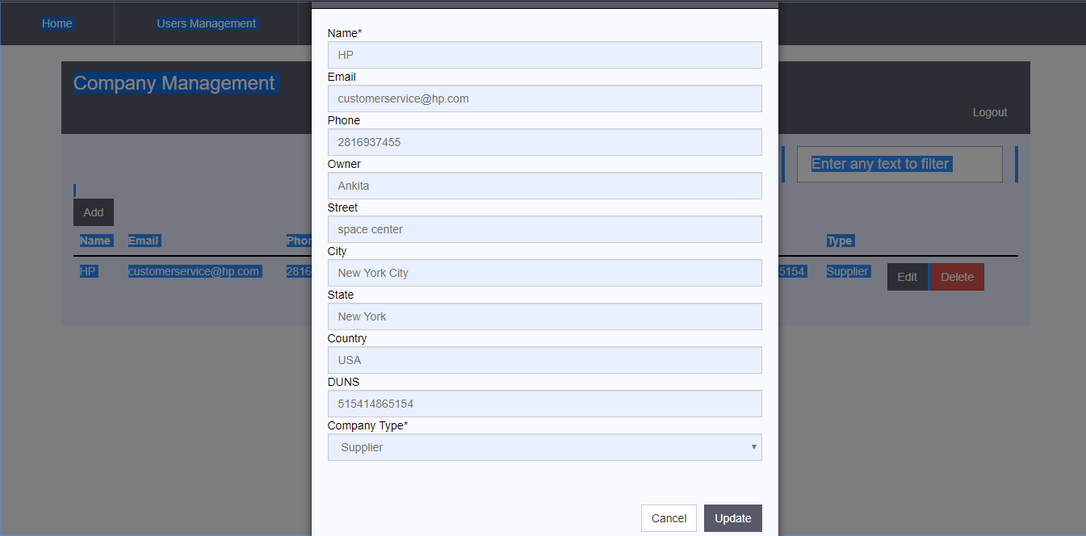
EDIT:

Slide 24
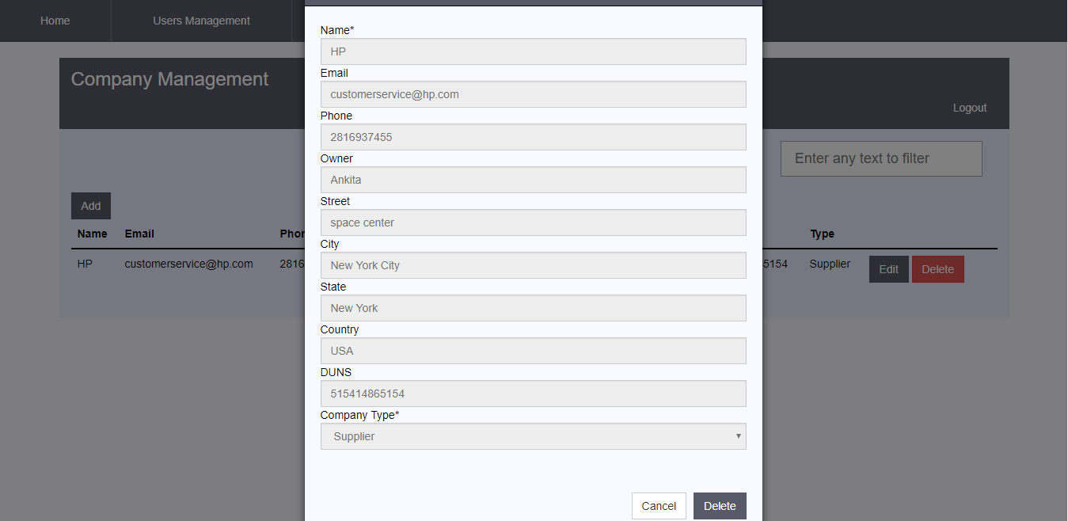
DELETE:

Slide 25
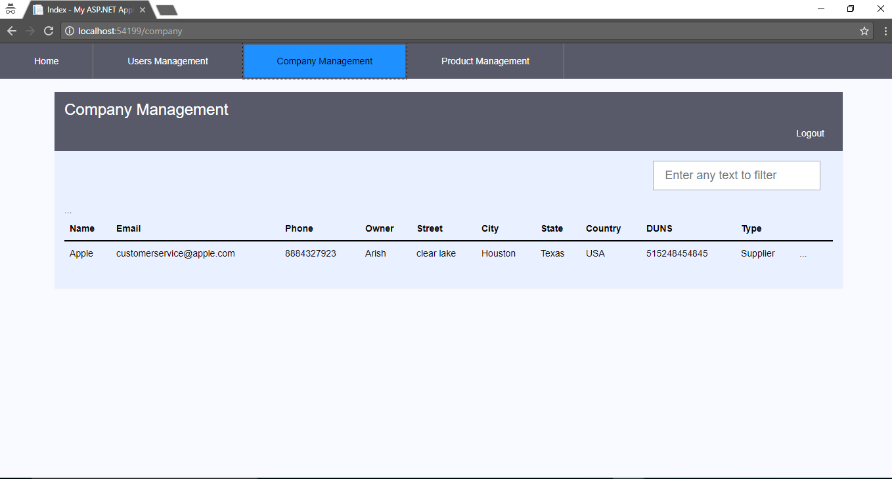
Users: Login

Slide 26
PRODUCT MANAGNMENT PAGE

Slide 27
Flow Chart

Slide 28
ER DIAGRAM:

Slide 29
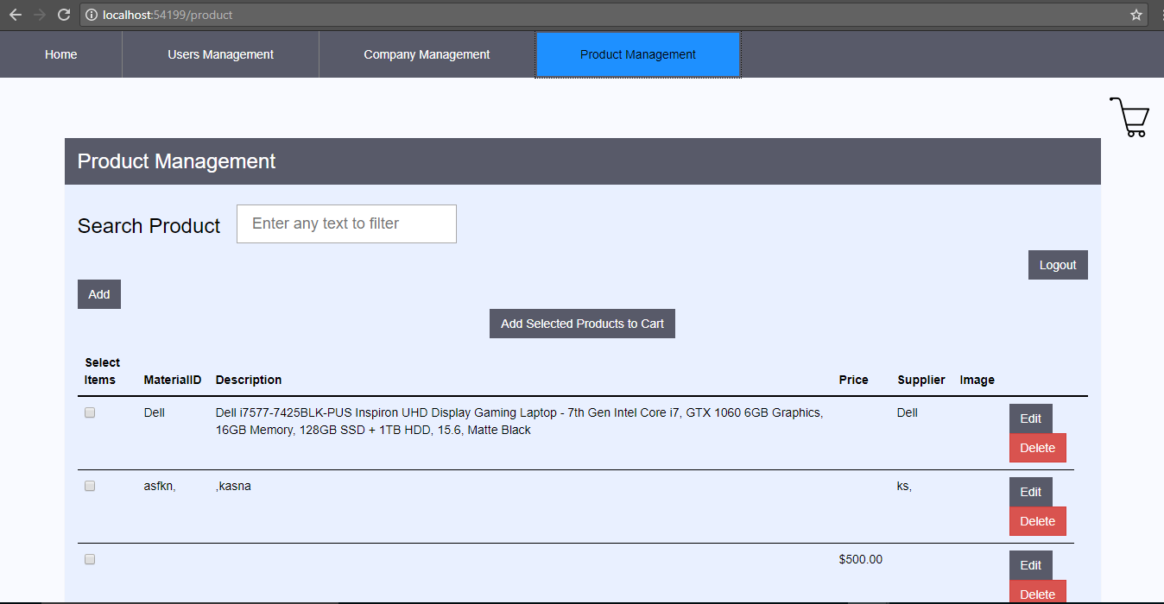
ADMIN:

Slide 30
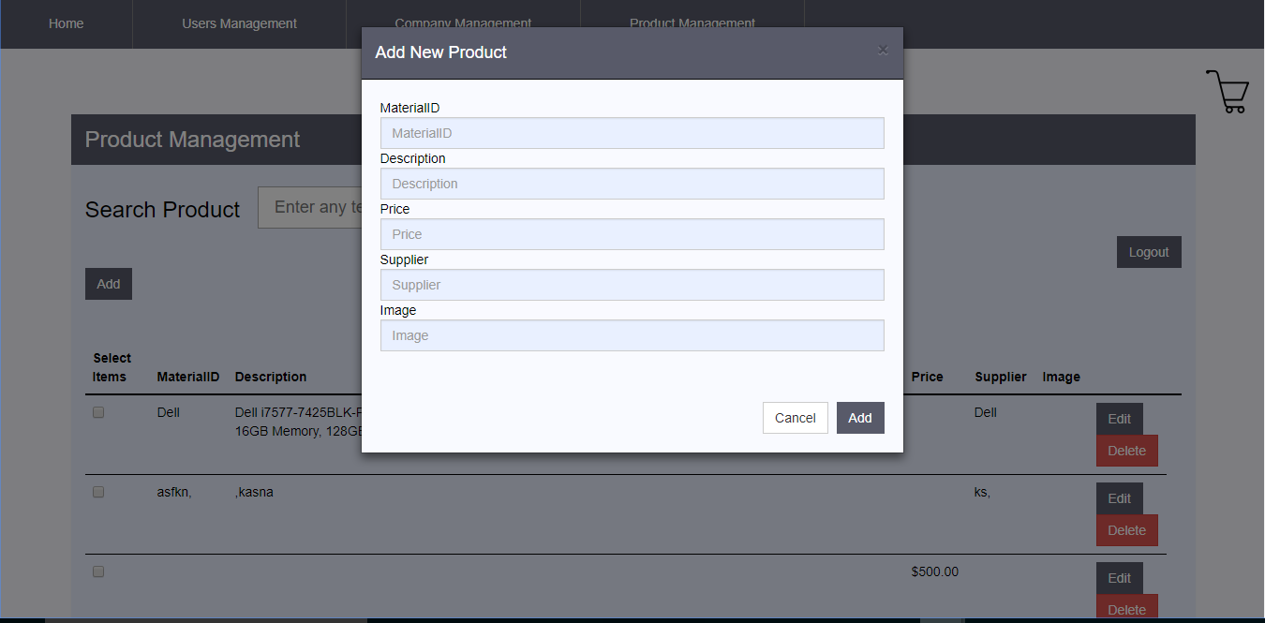
ADD:

Slide 31
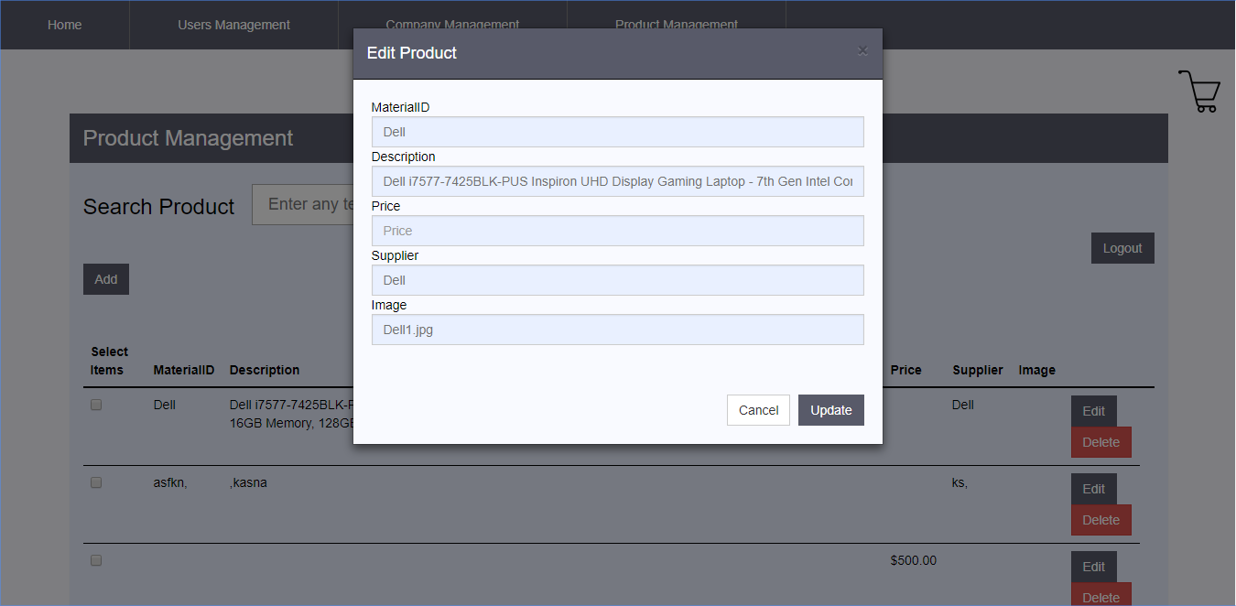
EDIT:

Slide 32
DELETE:

Slide 33
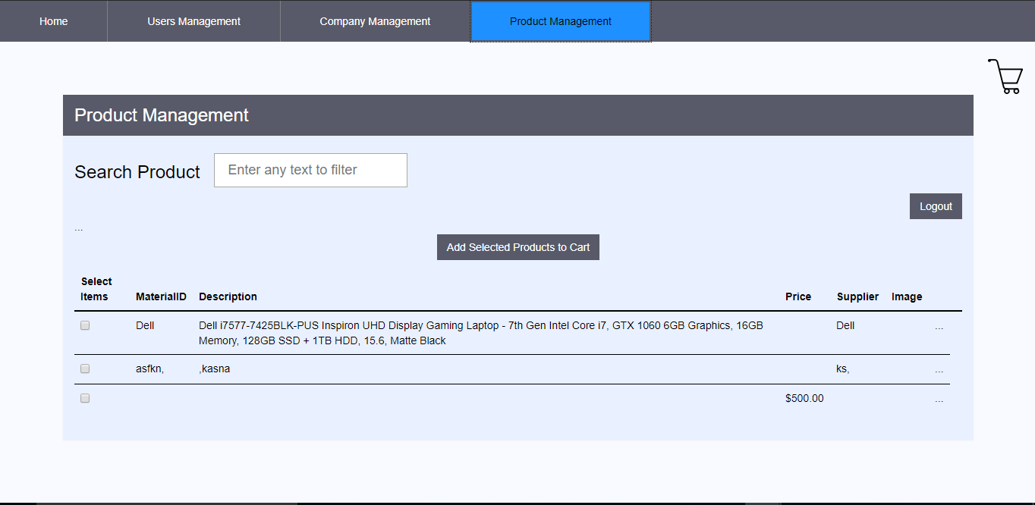
Users:

